Slide 1
Complete Business Story: E-commerce Insights
A comprehensive guide for E-commerce Executives, Advanced
Vivatech AI
Vincent de Paul NZOTEGOUONG
September 01, 2026
Made with SlideMaker.app

Slide 2

Complete Business Story: E-commerce Insights
This presentation delves into the critical performance metrics of our e-commerce platform, analyzing 12,205 sessions that resulted in 1,908 conversions, yielding a conversion rate of 15.63%. We will explore seasonal trends, traffic quality, and visitor behavior, providing actionable insights to optimize conversion rates. By understanding these dynamics, we can enhance our marketing strategies and improve customer engagement, ultimately driving revenue growth. Join us as we uncover the story behind the numbers.
Made with SlideMaker.app

Slide 3

Complete Business Story
Overall Performance Metrics
Seasonal Conversion Trends
Analyzed 12,205 sessions resulting in 1,908 conversions, achieving a conversion rate of 15.63%. This highlights the effectiveness of current strategies and areas for improvement.
Conversion rates show a clear seasonal pattern, peaking in November at 15.63% and declining in December. This indicates the need for targeted marketing strategies during peak months.
Traffic Quality Insights
Visitor Behavior Analysis
Traffic Type 16 achieves a 33% conversion rate, while Type 13 only converts at 5%. This 28-point gap suggests significant differences in traffic source effectiveness.
New visitors convert at 24.93%, compared to 14.09% for returning visitors. This discrepancy indicates potential for optimizing engagement strategies for returning users.
Made with SlideMaker.app
Photo by Shoper

Slide 4
Data Overview
Overall Performance Insights
Traffic Quality Disparities
Visitor Behavior Analysis
Analyzed data from 12,205 sessions revealed 1,908 conversions, resulting in a conversion rate of 15.63%. This indicates significant performance gaps that warrant further investigation.
Traffic quality varies significantly between sources, with Type 16 achieving a 33% conversion rate compared to Type 13's 5%. This 28-point gap highlights the need for targeted acquisition strategies.
New visitors convert at 24.93%, while returning visitors only achieve 14.09%. This 10.84-point difference suggests potential optimization opportunities for engaging returning customers.
Made with SlideMaker.app

Slide 5
Seasonal Conversion Trends
Made with SlideMaker.app

Slide 6
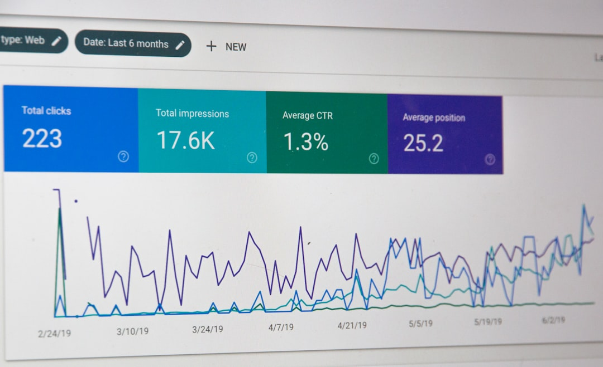
Traffic Quality Analysis
High Intent Traffic Type 16
Traffic Type 16 achieves a remarkable 33% conversion rate, indicating high visitor intent and engagement. This suggests a strong alignment between traffic source and customer purchasing behavior.
Low Performance Traffic Type 13
In stark contrast, Traffic Type 13 only converts at 5%. This significant disparity underscores the necessity to refine traffic acquisition strategies to enhance overall conversion rates.
Optimize Acquisition Strategies
Investigating the characteristics of Traffic Type 16 can provide insights into effective acquisition strategies. Leveraging these insights may drive improved conversion rates across all traffic sources.
Photo by Stephen Phillips - Hostreviews.co.uk
Made with SlideMaker.app

Slide 7

Visitor Behavior Insights
New vs. Returning Visitors
New visitors convert at 24.93%, nearly double the 14.09% for returning visitors. This disparity highlights a significant optimization opportunity for enhancing returning visitor engagement.
Investigate Conversion Drop
Understanding the reasons behind lower conversion rates for returning visitors is crucial. Factors may include checkout friction, lack of personalized offers, or ineffective remarketing strategies.
Targeted Marketing Efforts
Implementing targeted marketing strategies, such as personalized recommendations and loyalty incentives, can significantly enhance engagement and conversion rates among returning visitors.
Photo by sofia inductgroup
Made with SlideMaker.app

Slide 8
Key Features
Visitor Behavior Analysis
Risk Assessment
Personalized Recommendations
AI analyzes visitor interactions to identify high-risk sessions for potential recovery.
Prioritizes recovery actions based on user engagement metrics and session quality.
Generates tailored recovery messages to enhance customer engagement and conversion.
Controlled Decision-Making
Scalable Automation
Business rules guide AI recommendations, ensuring accountability and oversight.
Automates the recovery process, allowing for efficient handling of large volumes of sessions.
Made with SlideMaker.app

Slide 9
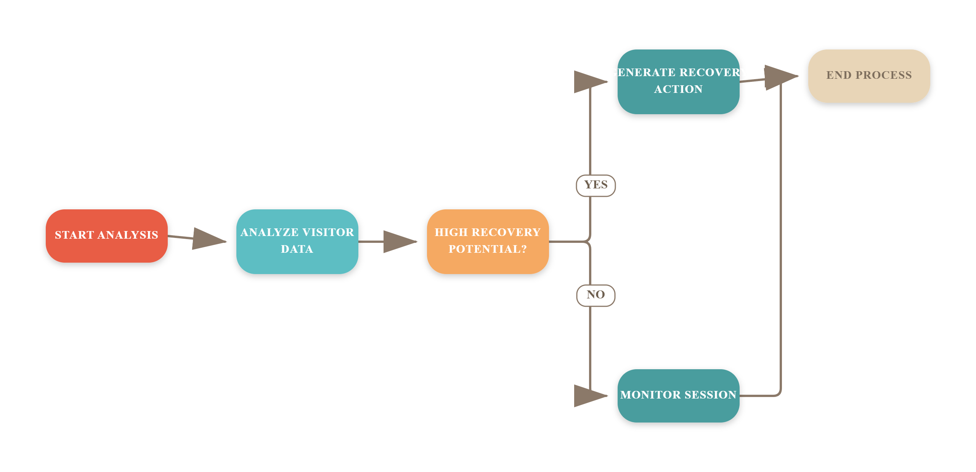
E-commerce Recovery Process Flow
Made with SlideMaker.app

Slide 10
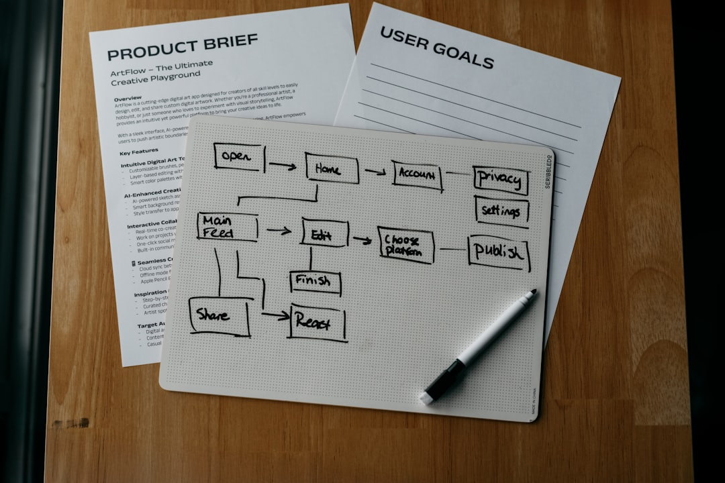
Implementing the POC
Manual Workflow Triggers
Session Evaluation Model
Workflows are initiated manually to capture visitor data, ensuring that each session is evaluated for recovery potential based on real-time engagement metrics.
The AI model assesses session details, including duration and visitor type, to determine the likelihood of recovery, providing actionable insights for targeted interventions.
Test Case Example
For a returning visitor with a session duration of 90 seconds, the AI outputs a recovery risk assessment, indicating high potential for targeted recovery actions.
Made with SlideMaker.app
Photo by Kelly Sikkema

Slide 11

Evaluating AI Effectiveness
Three Experiments Conducted
Monitored Key Metrics
We executed three distinct experiments, each comprising five test cases, to rigorously assess the AI's performance and reliability in real-world scenarios.
Key metrics such as correctness, latency, and hallucination rates were closely monitored, providing insights into the AI's operational efficiency and output reliability.
Identified Improvement Areas
The evaluation framework highlighted areas for improvement, particularly in data grounding and accuracy, ensuring the AI outputs are relevant and actionable for business needs.
Made with SlideMaker.app
Photo by Markus Winkler

Slide 12
Key Metrics & Impact
€90–€400
1-2 weeks
€4,500
Initial Investment
Monthly Operating Costs
Estimated cost to kickstart the AI project
POC Timeline
Rapid implementation for proof of concept
Variable costs depending on usage and infrastructure
Made with SlideMaker.app

Slide 13
Complete Business Story Summary
Overall Performance Metrics
Seasonal Conversion Trends
Analyzed 12,205 sessions resulting in 1,908 conversions, achieving a conversion rate of 15.63%. This indicates strong engagement and potential for revenue growth through optimization.
Conversion rates increase from February to November, peaking in November before declining in December. This seasonal pattern suggests opportunities for targeted marketing strategies during peak months.
Traffic Quality Insights
Visitor Behavior Analysis
Traffic Type 16 shows a 33% conversion rate, while Type 13 only achieves 5%. This 28-point gap highlights the need to focus on high-quality traffic sources for better performance.
New visitors convert at 24.93%, compared to 14.09% for returning visitors. This discrepancy indicates a need for strategies to enhance returning visitor engagement and conversion.
Made with SlideMaker.app

Slide 14
Action Items vs. Challenges
Proposed Actions
Identified Challenges
Investigate Traffic Type 16 for scaling opportunities.
Address AI evaluation challenges to ensure accuracy.
Explore why returning visitors show lower conversion rates.
Ensure data quality and integrity for reliable insights.
Manage integration complexity with existing systems.
Analyze seasonal trends to optimize campaign timing.
Validate the business impact of AI recommendations.
Implement personalized recommendations for returning visitors.
Mitigate risks related to data protection and GDPR compliance.
Test remarketing campaigns to boost conversion rates.
Made with SlideMaker.app

Slide 15
Frequently Asked Questions
?
How will AI decisions be monitored?
AI decisions will be monitored through LangSmith, which evaluates correctness, latency, and potential hallucinations to ensure transparency and reliability.
?
What safeguards are in place for data privacy?
We adhere to GDPR compliance and implement strict data protection measures to ensure that all customer information is handled securely and responsibly.
?
What metrics will define success in the pilot?
Success will be measured by the increase in conversion rates, the accuracy of AI recommendations, and the overall revenue recovery from non-converting sessions.
?
How will we optimize based on pilot results?
We will analyze pilot data to identify trends and areas for improvement, allowing us to refine AI algorithms and enhance customer engagement strategies.
Made with SlideMaker.app

Slide 16
Key Takeaways
In summary, our analysis reveals critical insights: a 15.63% overall conversion rate, significant seasonal trends with peaks in November, and stark traffic quality differences. New visitors convert at 24.93%, while returning visitors lag at 14.09%. To optimize performance, we recommend focusing on enhancing returning visitor engagement, leveraging high-quality traffic sources, and capitalizing on seasonal trends. Future efforts should prioritize targeted interventions to boost conversions and recover lost revenue opportunities.
Made with SlideMaker.app

